Slide 1
Explore the Power of Microsoft Graph
1

Slide 2
Agenda
Day 1 - Identity fundamentals with permissions and consent - Microsoft Graph overview with demo - What's new with Microsoft Graph Day 2 - Tips and Tricks on Microsoft Graph - Advanced querying with Microsoft Graph
- Pre-integrate your applications with Azure AD

Slide 3





Microsoft 365
Identity
Productivity
Devices
Security
Microsoft Graph

Slide 4

Microsoft Graph
…is the Microsoft 365 data that describes the patterns of productivity, identity and security in an organization, accessed through a unified API endpoint.

Slide 5
Microsoft Graph powers our products

Slide 6

Applications need to access resources
Application
Resource
Microsoft Graph API
Notes:
Concept of tokens – Different types (ID and Access tokens)
Flow of application
Private conversation between AAD and the user before you talk to the web API

Slide 7
Resources need protection - Authorization
Authorization Required
Microsoft Graph API
Notes:
Concept of tokens – Different types (ID and Access tokens)
Flow of application
Private conversation between AAD and the user before you talk to the web API

Slide 8
Adding Authorization to an App

Slide 9
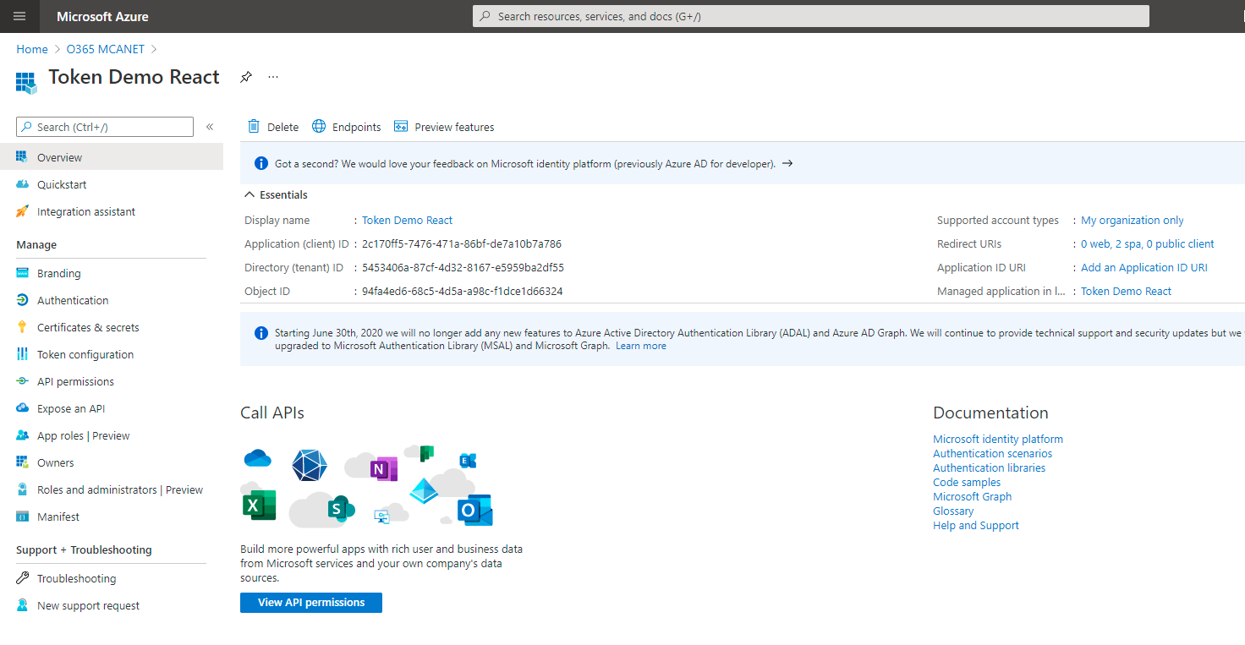
App Registration: App Trusts Microsoft identity platform
What Azure AD considers “the app”
Information about the app:
Name, logo, and publisher
Reply URLs, Secrets, …
One App Registration per App
“Application Object”

Slide 10
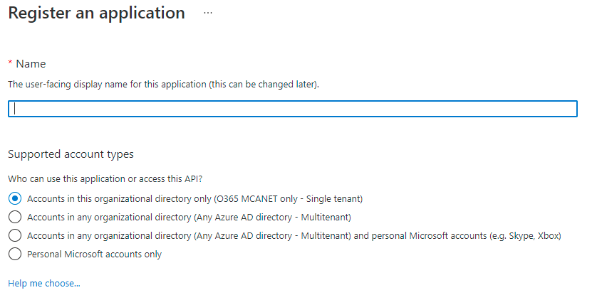
App Registration: Support account types?
Second required question when registering an app.

Slide 11
“Accounts in this organizational directory only”
Adatum
App Registration
Only allows users from the tenant where the app is registered
Known as a Single-tenant app

Slide 12
Registering the app is not enough
Need:
User and group application and role assignments
Permissions granted to the application
Policies including conditional access policy
Alternate local settings for an application
Visible in Enterprise Applications
Service Principal

Slide 13
Single Tenant App
Adatum
Contoso
App Registration
Adatum Enterprise App (Consent)
User A
Adatum Data
User B
User B

Slide 14
“Accounts in any organizational directory”
Adatum
Contoso
Adatum App Registration
Adatum Enterprise App
(Consent)
Contoso Enterprise App
(Consent)
User A
User B
User B
Adatum Data
Contoso Data
Uses common, organizations, or consumers, endpoints to sign in
No invitation/external account needed
Known as a Multi-tenant app

Slide 15
External Identities (aka B2B)
Adatum
Contoso
App Registration
Adatum Enterprise App (Consent)
User A
Adatum Data
Invite
Authentication when needed
Guest User B
Use Adatum endpoint to sign in
Can’t use common, organizations, nor consumers, endpoints
Invitation/external account needed
User B
User B

Slide 16
Demo Application registration
16

Slide 17
Application requests permission
Want to access resource (scope)
Authorization Required
Microsoft Graph API
Notes:
Concept of tokens – Different types (ID and Access tokens)
Flow of application
Private conversation between AAD and the user before you talk to the web API

Slide 18

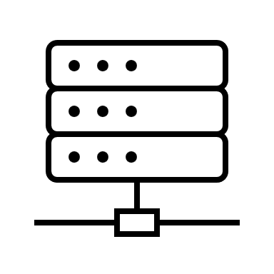
Azure AD checks for authorization
Want to access resource (scope)
Is app allowed to access the resource?
Authorization Required
Microsoft Graph API
Notes:
Concept of tokens – Different types (ID and Access tokens)
Flow of application
Private conversation between AAD and the user before you talk to the web API

Slide 19
Permission is Granted or Denied - Consent
Want to access resource (scope)
Is app allowed to access the resource?
A
Authorization Required
Microsoft Graph API
Notes:
Concept of tokens – Different types (ID and Access tokens)
Flow of application
Private conversation between AAD and the user before you talk to the web API

Slide 20
Access token sent to app
Want to access resource (scope)
A
Authorization Required
Microsoft Graph API
Notes:
Concept of tokens – Different types (ID and Access tokens)
Flow of application
Private conversation between AAD and the user before you talk to the web API

Slide 21
App has access token - permission - authorization
Authorization Required
A
Microsoft Graph API
Notes:
Concept of tokens – Different types (ID and Access tokens)
Flow of application
Private conversation between AAD and the user before you talk to the web API

Slide 22
Still have a problem?
A
Authorization Required
Microsoft Graph API
Notes:
Concept of tokens – Different types (ID and Access tokens)
Flow of application
Private conversation between AAD and the user before you talk to the web API

Slide 23




https://graph.microsoft.com
graph.microsoft.com
graph.microsoft.com
USERS
GROUPS
FILES
MAIL
CALENDAR
TASKS
Insights and relationships from Graph

Slide 24
Some APIs have a rich surface area
Authorization Required
USERS
GROUPS
FILES
MAIL
CALENDAR
TASKS
…
Notes:
Concept of tokens – Different types (ID and Access tokens)
Flow of application
Private conversation between AAD and the user before you talk to the web API

Slide 25
Least Privilege – Asking for just enough
Read users
USERS
Update users
Read Groups
Want to Read Calendar (scope)
GROUPS
Read Cal
Update Groups
Read Files
FILES
Update Files
Read Mail
MAIL
Update Mail
Read Calendar
CALENDAR
Update Calendar
Read Tasks
TASKS
Update Tasks
…
Notes:
Concept of tokens – Different types (ID and Access tokens)
Flow of application
Private conversation between AAD and the user before you talk to the web API

Slide 26
Least Privilege – Granting just enough
Read users
USERS
Update users
Read Groups
Want to Read Calendar (scope)
GROUPS
Read Cal
Update Groups
Read Files
FILES
Update Files
Read Mail
MAIL
Update Mail
Read Calendar
CALENDAR
Update Calendar
Read Tasks
TASKS
Update Tasks
…
Notes:
Concept of tokens – Different types (ID and Access tokens)
Flow of application
Private conversation between AAD and the user before you talk to the web API

Slide 27
App has Least Privilege – just enough
Read users
USERS
Update users
Read Groups
GROUPS
Update Groups
Read Files
FILES
Update Files
Read Mail
MAIL
Update Mail
Read Calendar
CALENDAR
Update Calendar
Read Tasks
Read Cal
TASKS
Update Tasks
…
Notes:
Concept of tokens – Different types (ID and Access tokens)
Flow of application
Private conversation between AAD and the user before you talk to the web API

Slide 28
App has Least Privilege – just enough
Read users
USERS
Update users
Read Groups
GROUPS
Update Groups
Read Files
FILES
Update Files
Read Mail
Read Cal
MAIL
Update Mail
Read Calendar
CALENDAR
Update Calendar
Read Tasks
TASKS
Update Tasks
…
Notes:
Concept of tokens – Different types (ID and Access tokens)
Flow of application
Private conversation between AAD and the user before you talk to the web API

Slide 29
Least Privilege – Asking for just enough
Read users
USERS
Update users
Read Groups
GROUPS
Update Groups
Read Files
FILES
Update Files
Read Mail
Read Cal
MAIL
Update Mail
Read Calendar
CALENDAR
Update Calendar
Read Tasks
TASKS
Update Tasks
…
Notes:
Concept of tokens – Different types (ID and Access tokens)
Flow of application
Private conversation between AAD and the user before you talk to the web API

Slide 30
Types of permissions
Delegated permissions
Permissions which operate in the context of the signed-in user.
Always used if a user is present
Application permissions
Permissions that have effect on behalf of the client app itself, with no user present.
Used only when no user is present

Slide 31
Delegated Permissions

Slide 32

Application requests permission
Want to access resource (scope) on behalf of the user
Authorization Required
When a user is present the app is compelled to use delegated permissions
Microsoft Graph API
Notes:
Concept of tokens – Different types (ID and Access tokens)
Flow of application
Private conversation between AAD and the user before you talk to the web API

Slide 33
Azure AD needs to know the user
Want to access resource (scope) on behalf of the user
Authorization Required
Broker 🍪
Private conversation with the user
Microsoft Graph API
Notes:
Concept of tokens – Different types (ID and Access tokens)
Flow of application
Private conversation between AAD and the user before you talk to the web API

Slide 34
Azure AD checks for authorization
Want to access resource (scope)
Is app allowed to access the resource?
Admin consent granted?
User has granted consent to app?
Authorization Required
Microsoft Graph API
Notes:
Concept of tokens – Different types (ID and Access tokens)
Flow of application
Private conversation between AAD and the user before you talk to the web API

Slide 35
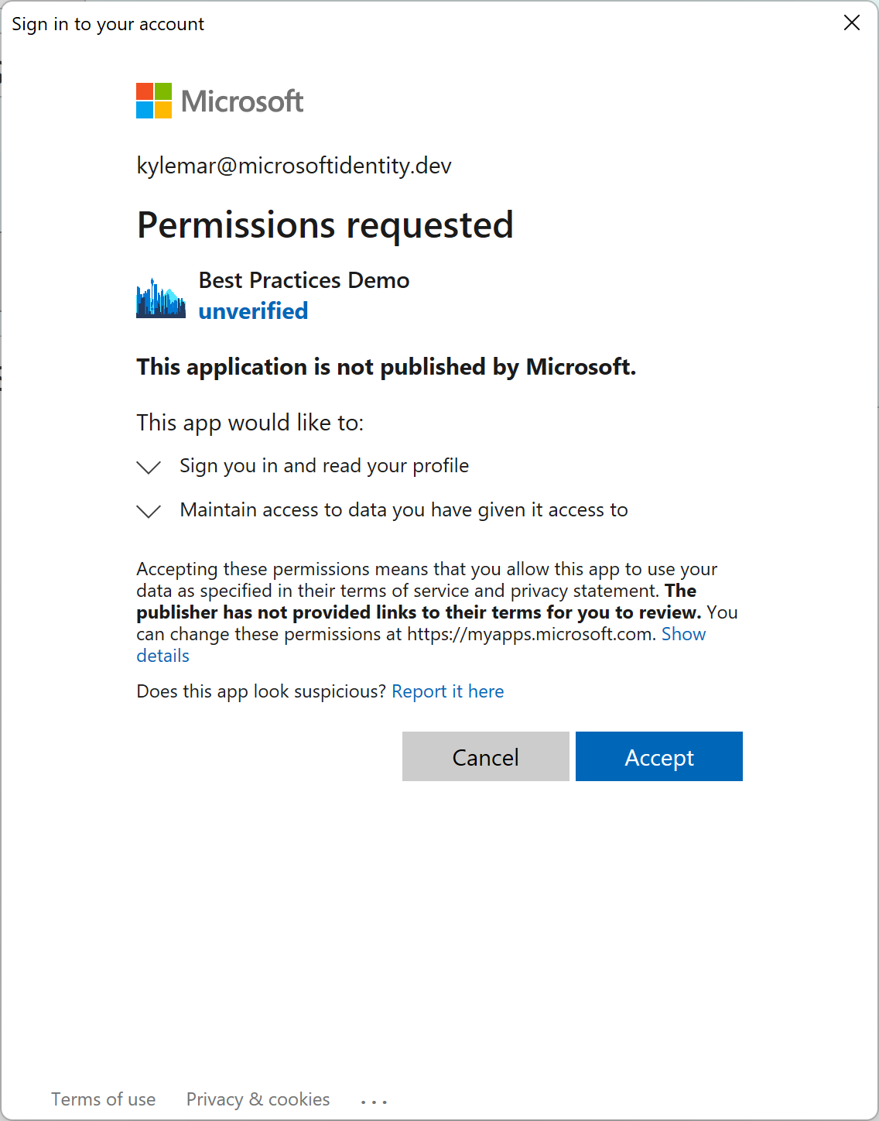
Azure AD checks for authorization
Want to access resource (scope)
Is app allowed to access the resource?
Authorization Required
Broker 🍪
Private conversation with the user
Microsoft Graph API
Notes:
Concept of tokens – Different types (ID and Access tokens)
Flow of application
Private conversation between AAD and the user before you talk to the web API

Slide 36
Azure AD checks for authorization
Want to access resource (scope)
Is app allowed to access the resource?
Authorization Required
Broker 🍪
Private conversation with the user
Microsoft Graph API
Notes:
Concept of tokens – Different types (ID and Access tokens)
Flow of application
Private conversation between AAD and the user before you talk to the web API

Slide 37
Azure AD checks for authorization
Want to access resource (scope)
Is app allowed to access the resource?
Authorization Required
Broker 🍪
Private conversation with the user
Microsoft Graph API
Notes:
Concept of tokens – Different types (ID and Access tokens)
Flow of application
Private conversation between AAD and the user before you talk to the web API

Slide 38
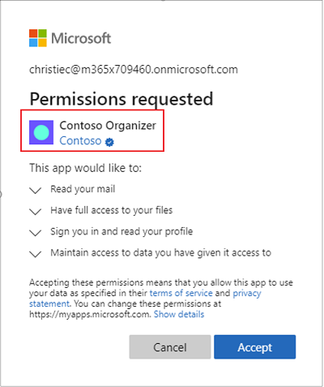
Publisher verification
Helps to understand the authenticity of application developers
Increased transparency and risk reduction for customers
Improved branding
Smoother enterprise adoption

Slide 39
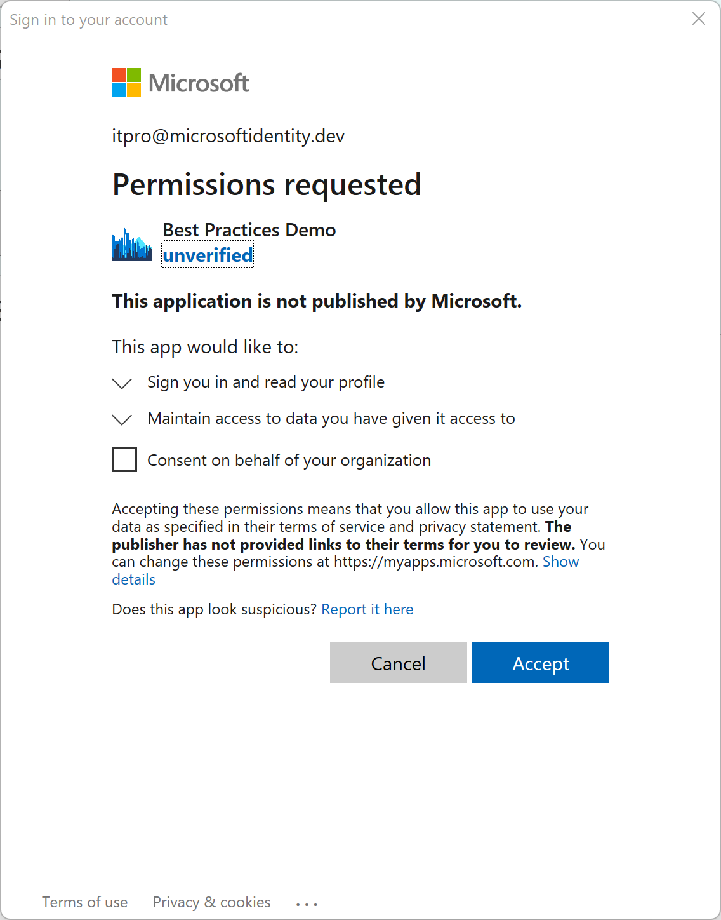
Azure AD checks for authorization
Want to access resource (scope)
Is app allowed to access the resource?
Authorization Required
Broker 🍪
Private conversation with the user
Microsoft Graph API
Notes:
Concept of tokens – Different types (ID and Access tokens)
Flow of application
Private conversation between AAD and the user before you talk to the web API

Slide 40
Permission is Granted or Denied - Consent
Want to access resource (scope)
A
Authorization Required
Microsoft Graph API
Notes:
Concept of tokens – Different types (ID and Access tokens)
Flow of application
Private conversation between AAD and the user before you talk to the web API

Slide 41
Permission is Granted or Denied - Consent
Want to access resource (scope)
A
Authorization Required
Microsoft Graph API
Notes:
Concept of tokens – Different types (ID and Access tokens)
Flow of application
Private conversation between AAD and the user before you talk to the web API

Slide 42
App has access token - authorization
Want to access resource (scope)
Authorization Required
A
Microsoft Graph API
Notes:
Concept of tokens – Different types (ID and Access tokens)
Flow of application
Private conversation between AAD and the user before you talk to the web API

Slide 43
App can access resource
Resource MUST check authorization of the app (token validation) and the user (up to the resource)
A
Authorization Required
Microsoft Graph API
Notes:
Concept of tokens – Different types (ID and Access tokens)
Flow of application
Private conversation between AAD and the user before you talk to the web API

Slide 44
Demo Declaring delegated permissions
Notes:
App registration
Open demo app
Go to API Permissions
Show permissions declared
Add a permission
Select Microsoft Graph
Select Delegated Permissions
Type user
Show permissions

Slide 45
When can an Application request consent?
While we strongly recommend applications declare all permissions the app requires, declaring permissions is NOT REQUIRED
Apps request permissions in the code of the app
Dynamically
Incrementally
Statically

Slide 46
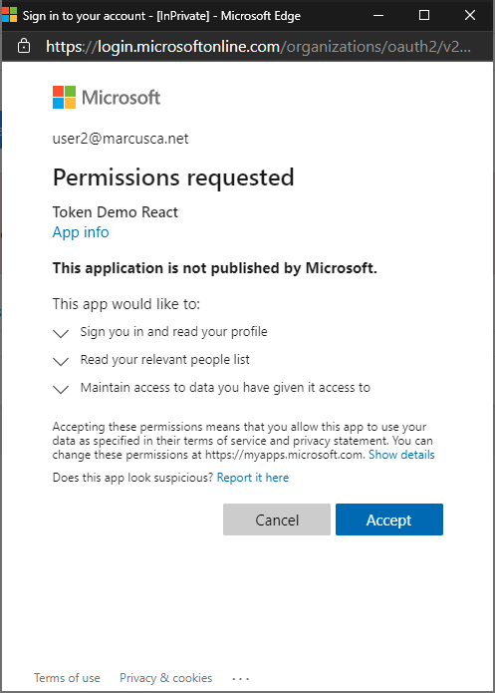
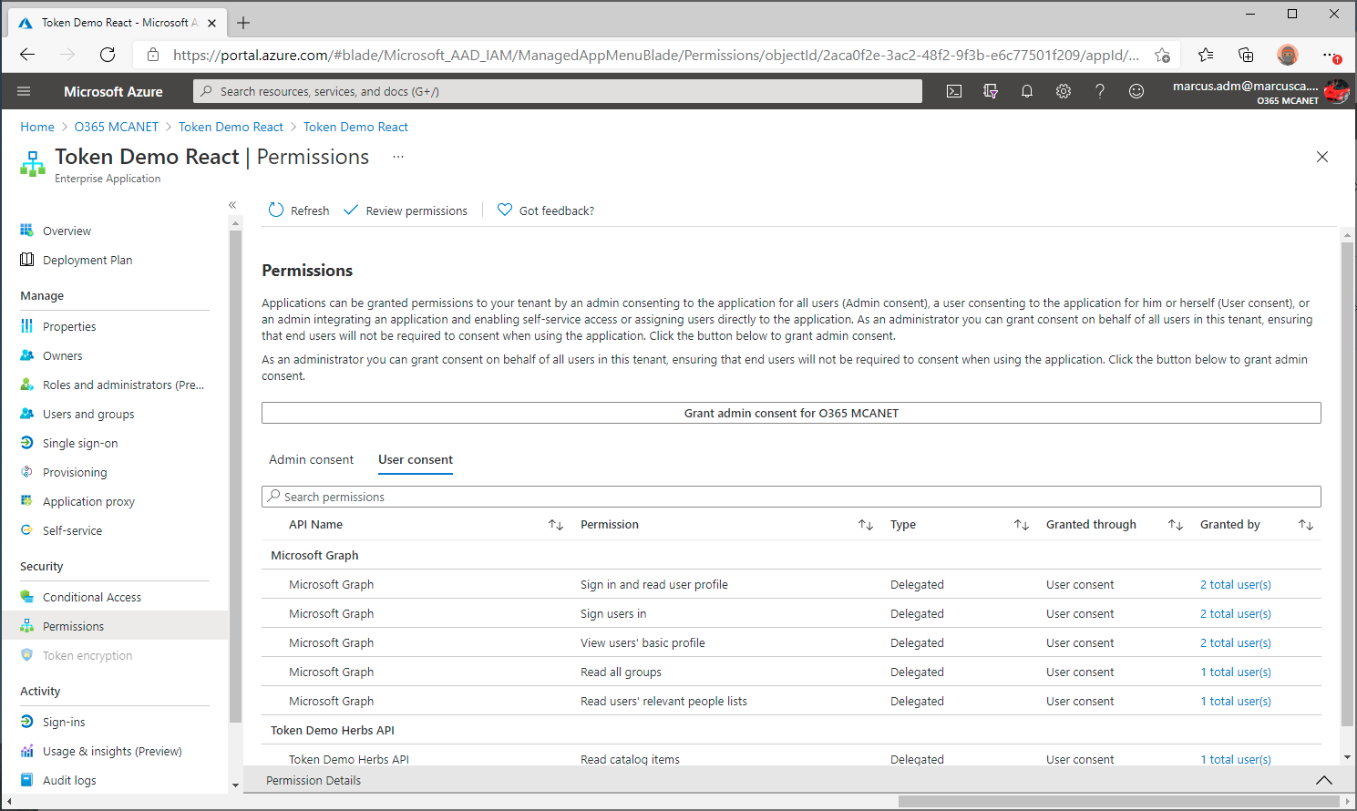
Dynamic consent: Permissions requested inside the code
App requests: User.Read People.Read
Generally, permissions that every user will need
Granted permissions visible under “Enterprise Applications”
Notes:
There are two other reason

Slide 47
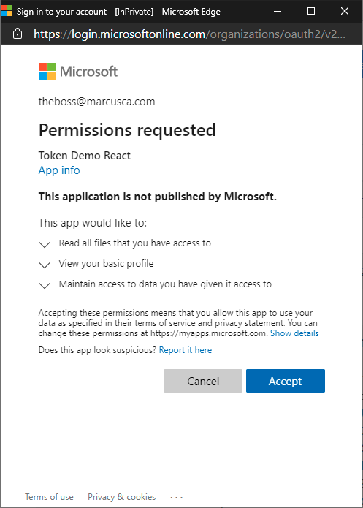
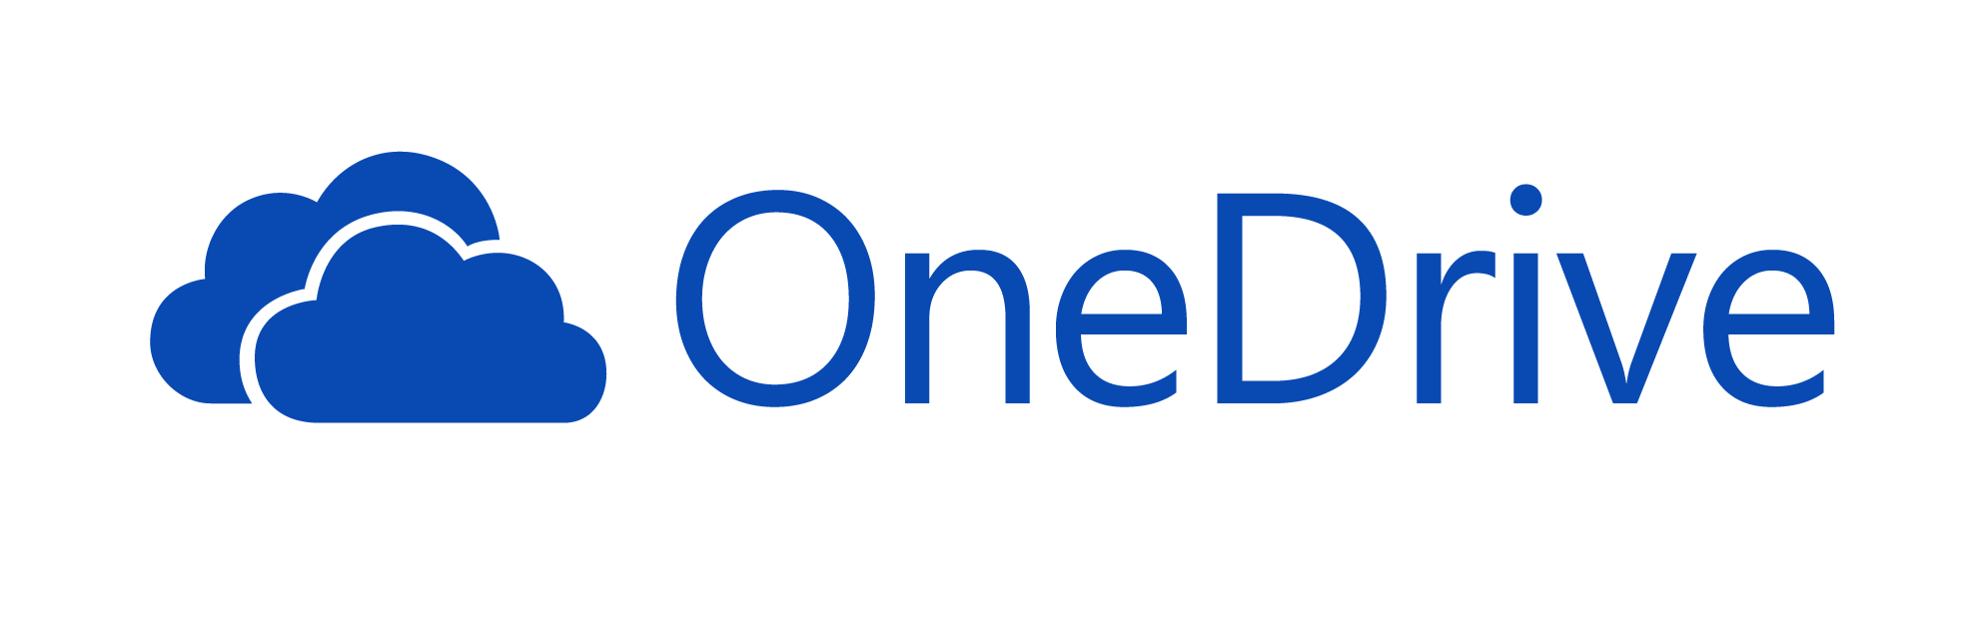
Incremental consent: Permissions requested as the user needs them
Certain permissions may scare off users, especially the first time they use the app
App requests: Files.Read.All

Slide 48
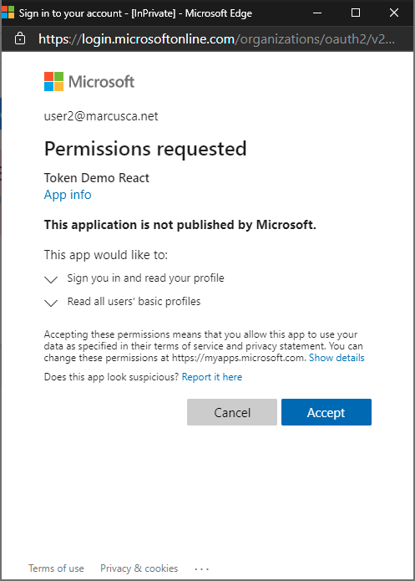
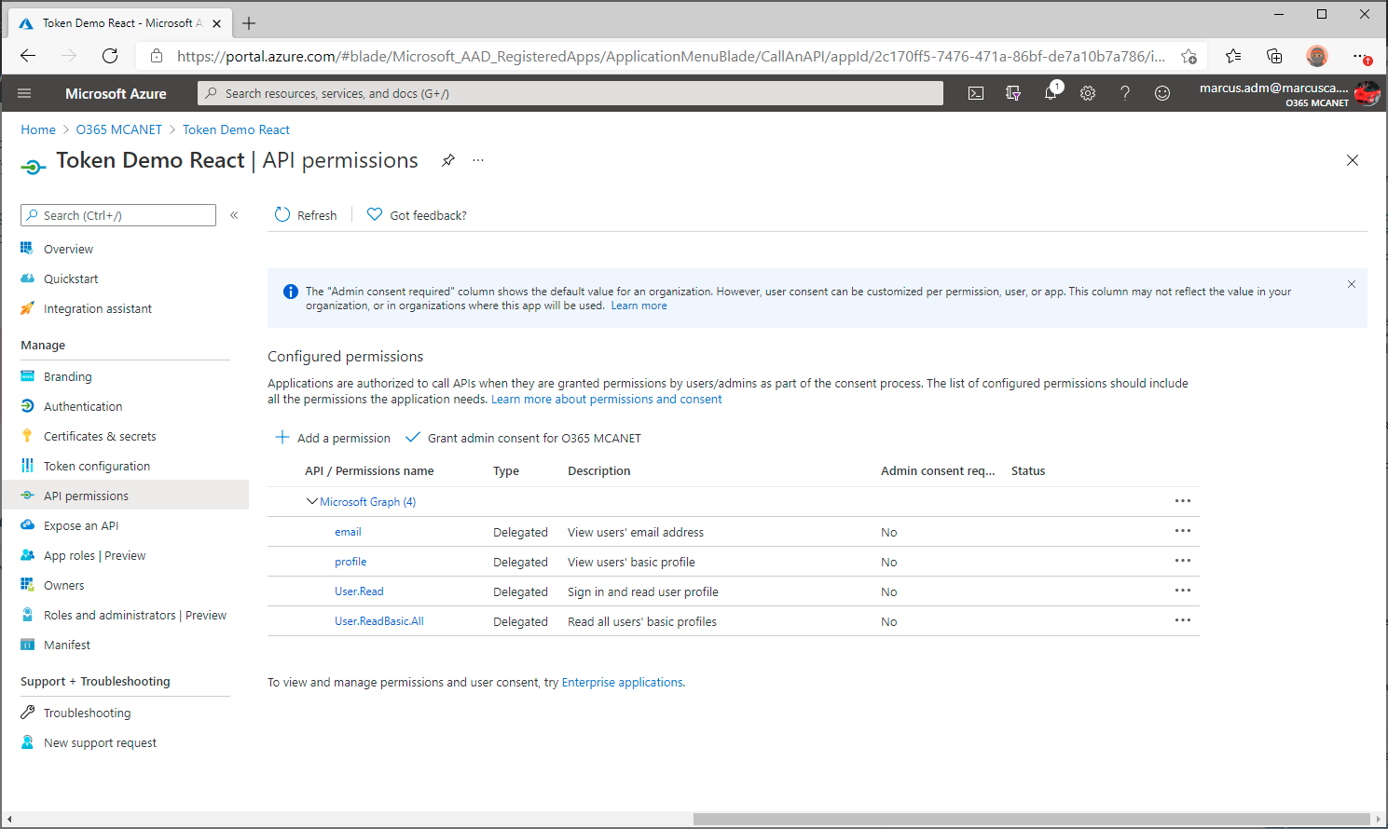
Static user consent: Permissions declared upfront by admin or app owner
Will represent all permissions configured in the App registration
App requests: .default
Note: /.default triggers a consent prompt only if the user has not granted permissions for the app to the resource
Notes:
There are two other reason

Slide 49
Delegated Permissions
Authorize an app to access a resource on behalf of the signed in user
Must be granted by the current user or an admin
App’s effective permission is the intersection of delegated permission and user capabilities
Apps can request access dynamically, incrementally, or statically

Slide 50
How does Microsoft use Permissions?
Let’s look at an example from Microsoft Graph

Slide 51
Microsoft Graph permissions names
Resource.Operation.Constraint
Constraint | What it does
All | Grants permission for the app to perform the operations on all of the resources of the specified type in a directory.
Shared | Grants permission for the app to perform the operations on resources that other users have shared with the signed-in user. This constraint is mainly used with Outlook resources like mail, calendars, and contacts.
AppFolder | Grants permission for the app to read and write files in a dedicated folder in OneDrive. This constraint is only exposed on Files permissions and is only valid for Microsoft accounts.
none | If no constraint is specified the app is limited to performing the operations on the resources owned by the signed-in user.

Slide 52
Microsoft Graph User Permissions (Examples)
Permission | Display String | Description
User.Read | Sign-in and read user profile | Allows users to sign-in to the app and allows the app to read the profile of signed-in users. It also allows the app to read basic company information of signed-in users.
User.ReadWrite | Read and write access to user profile | Allows the app to read the signed-in user's full profile. It also allows the app to update the signed-in user's profile information on their behalf.
User.ReadBasic.All | Read all users' basic profiles | Allows the app to read a basic set of profile properties of other users in your organization on behalf of the signed-in user. This includes display name, first and last name, email address, open extensions and photo. Also allows the app to read the full profile of the signed-in user.
https://docs.microsoft.com/en-us/graph/permissions-reference

Slide 53
More User Permissions…
Permission | Display String | Description
User.Read | Sign-in and read user profile | Allows users to sign-in to the app and allows the app to read the profile of signed-in users. It also allows the app to read basic company information of signed-in users.
User.ReadWrite | Read and write access to user profile | Allows the app to read the signed-in user's full profile. It also allows the app to update the signed-in user's profile information on their behalf.
User.ReadBasic.All | Read all users' basic profiles | Allows the app to read a basic set of profile properties of other users in your organization on behalf of the signed-in user. This includes display name, first and last name, email address, open extensions and photo. Also allows the app to read the full profile of the signed-in user.
User.Read.All | Read all users' full profiles | Allows the app to read the full set of profile properties, reports, and managers of other users in your organization, on behalf of the signed-in user.
User.ReadWrite.All | Read and write all users' full profiles | Allows the app to read and write the full set of profile properties, reports, and managers of other users in your organization, on behalf of the signed-in user. Also allows the app to create and delete users as well as reset user passwords on behalf of the signed-in user.

Slide 54
Admin Consent Required?
Permission | Display String | Description | Admin?
User.Read | Sign-in and read user profile | Allows users to sign-in to the app and allows the app to read the profile of signed-in users. It also allows the app to read basic company information of signed-in users. | No
User.ReadWrite | Read and write access to user profile | Allows the app to read the signed-in user's full profile. It also allows the app to update the signed-in user's profile information on their behalf. | No
User.ReadBasic.All | Read all users' basic profiles | Allows the app to read a basic set of profile properties of other users in your organization on behalf of the signed-in user. This includes display name, first and last name, email address, open extensions and photo. Also allows the app to read the full profile of the signed-in user. | No
User.Read.All | Read all users' full profiles | Allows the app to read the full set of profile properties, reports, and managers of other users in your organization, on behalf of the signed-in user. | Yes
User.ReadWrite.All | Read and write all users' full profiles | Allows the app to read and write the full set of profile properties, reports, and managers of other users in your organization, on behalf of the signed-in user. Also allows the app to create and delete users as well as reset user passwords on behalf of the signed-in user. | Yes

Slide 55
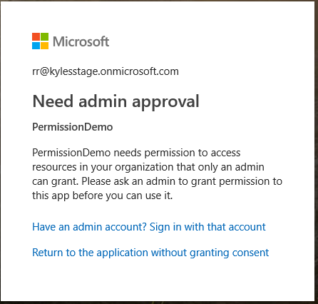
Users can not grant consent for a permission that requires Admin consent

Slide 56
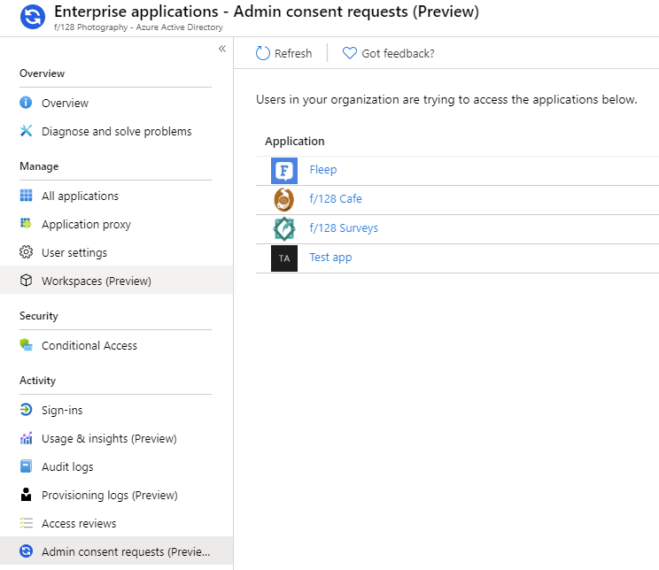
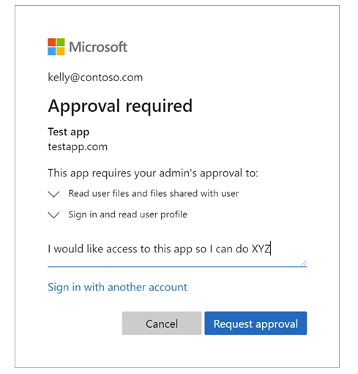

Slide 57
Admin Consent
Admins can consent for all users in the organization
Applies to both consent User and Admin permissions
When running the app
In the Azure Portal

Slide 58
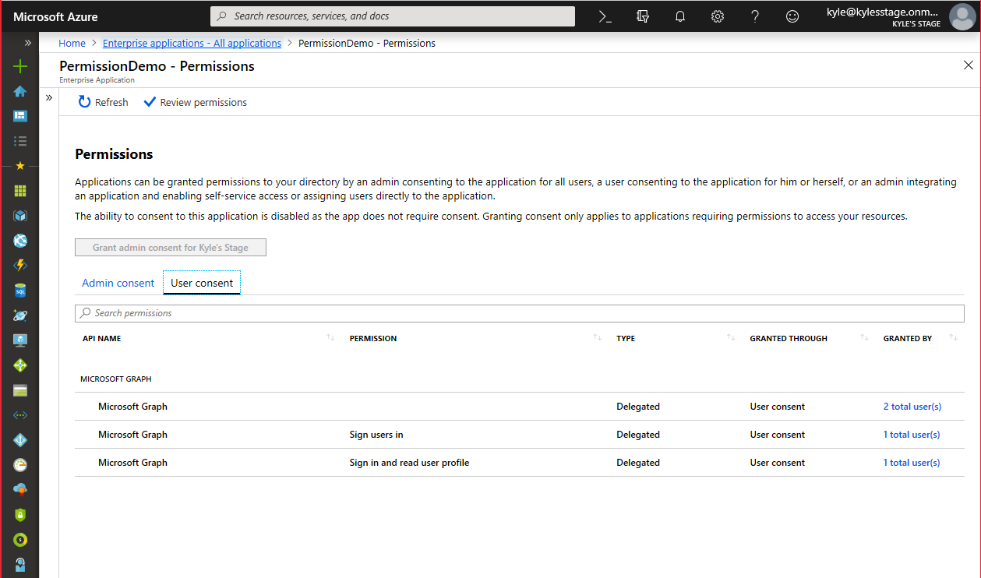
Great choice for LOB apps
Developers should declare all permissions ahead of time

Slide 59
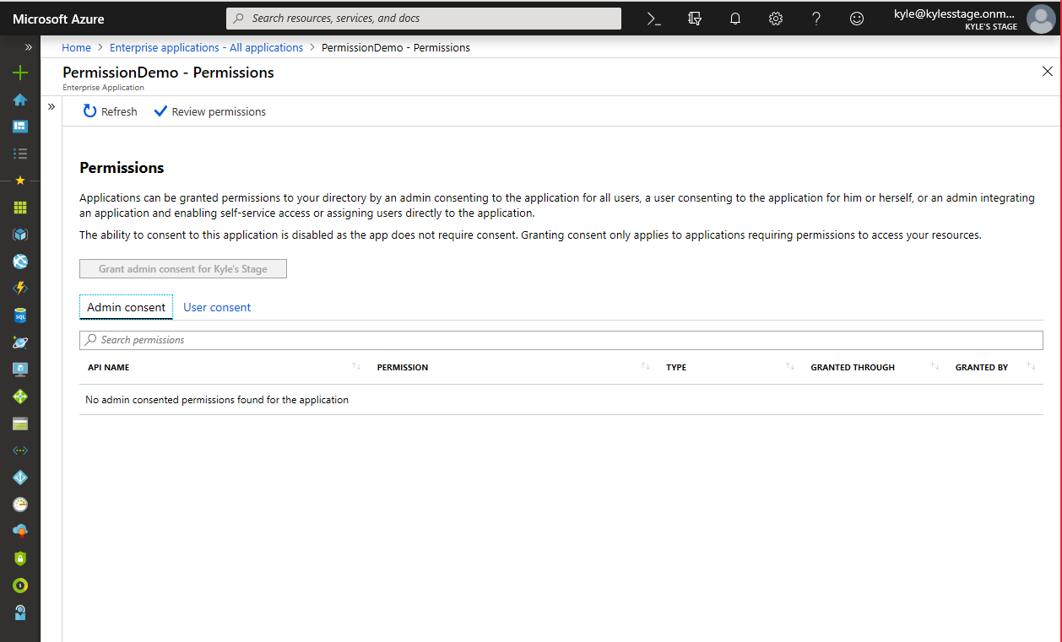

Slide 60
Application Permissions (Workloads)

Slide 61

Workload requests permission
Want to access resource Must use .default scope
-https://graph.microsoft.com/.default
Must provide Client Credential
Authorization Required
Microsoft Graph API
Notes:
Concept of tokens – Different types (ID and Access tokens)
Flow of application
Private conversation between AAD and the user before you talk to the web API

Slide 62
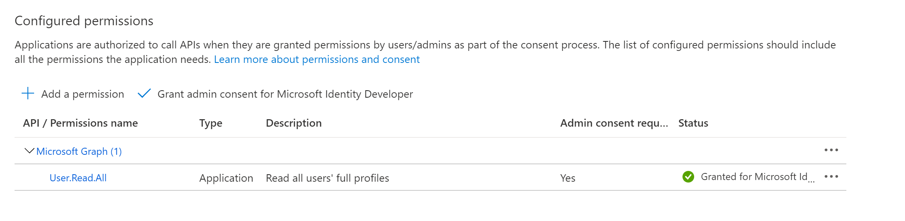
Azure AD checks for authorization
Want to access resource Must use .default scope
-https://graph.microsoft.com/.default
Is app allowed to access the resource?
Must provide Client Credential
Must be consented by Admin
Must be done before service runs
Authorization Required
Microsoft Graph API
Notes:
Concept of tokens – Different types (ID and Access tokens)
Flow of application
Private conversation between AAD and the user before you talk to the web API

Slide 63
Permission is Granted or Denied - Consent
Want to access resource Must use .default scope
-https://graph.microsoft.com/.default
Is app allowed to access the resource?
A
Must provide Client Credential
Authorization Required
Microsoft Graph API
Notes:
Concept of tokens – Different types (ID and Access tokens)
Flow of application
Private conversation between AAD and the user before you talk to the web API

Slide 64
Access token sent to app
Want to access resource Must use .default scope
-https://graph.microsoft.com/.default
A
Must provide Client Credential
Authorization Required
Microsoft Graph API
Notes:
Concept of tokens – Different types (ID and Access tokens)
Flow of application
Private conversation between AAD and the user before you talk to the web API

Slide 65
Workload has access token - permission - authorization
Authorization Required
A
Microsoft Graph API
Notes:
Concept of tokens – Different types (ID and Access tokens)
Flow of application
Private conversation between AAD and the user before you talk to the web API

Slide 66
App has access token - permission - authorization
A
Authorization Required
Microsoft Graph API
Notes:
Concept of tokens – Different types (ID and Access tokens)
Flow of application
Private conversation between AAD and the user before you talk to the web API

Slide 67
Demo Declaring application permissions
Notes:
App registration
Open demo service app
Go to API Permissions
Show permissions declared
Add a permission
Select Microsoft Graph
Select Application Permissions
Type user
Show permissions

Slide 68
Application Permissions - Workloads
App proves it is the app requesting permission with a client credential
Secret – OK (but needs help)
Certificates – Good
Workload identity federation - Good
Managed Identity for Azure Resources – Best if building on Azure
Ask the Azure Resource for the access token
Admin consent – Always
By default, app can access all instances of the resource
User.ReadWrite.All – update all users profiles
Calendars.Read – read all calendars in the tenant
Permissions granted the app are always the permissions used

Slide 69
Limit App Permissions
Resource Specific Consent
Microsoft Teams - Enable resource-specific consent in Teams - Teams | Microsoft Docs
Exchange Application Policies
Mailboxes - Limiting application permissions to specific Exchange Online mailboxes - Microsoft Graph | Microsoft Docs
Sites.Selected
SharePoint - Controlling app access on a specific SharePoint site collections is now available in Microsoft Graph - Microsoft 365 Developer Blog

Slide 70
Application Permissions
Authorize an app to access a resource
Must be granted by an admin before the app runs
By default, access is to all instances of the resource
Teams, Exchange, and SharePoint have methods to limit access
Apps must use .default to request access

Slide 71
Back to Microsoft Graph

Slide 72
Find all the events in my Outlook calendar
GET https://graph.microsoft.com/v1.0/me
/events?$select=subject
me
Create a new folder in my OneDrive service
POST https://graph.microsoft.com/v1.0/me
/drive/root/children
me
Get me a list of all the conference rooms in my building
GET https://graph.microsoft.com/beta/me
/findRoomLists
me

Slide 73
Popular data sets
Mail
Conversations
Tasks
Users
Files
Events

Slide 74
Activities
Attachments
Audits
Calendar
Categories
Charts
Classes
Contacts
Conversations
Cross-device experiences
Customer booking
Device configuration
Device management
Domains
Education
Events
Files
Financials
Groups
Identity
Lists
Mail
Messages
Notes
Notifications
Pages
Places
Plans
Reports
Schools
Search
Secure score
Security alerts
Sites
Social
Subscriptions
Tasks
Teams
Threat intelligence
Users
Workbooks
…and many, many more

Slide 75







Cross-platform support
.NET
Tier 1
Objective-C
Tier 2

Slide 76
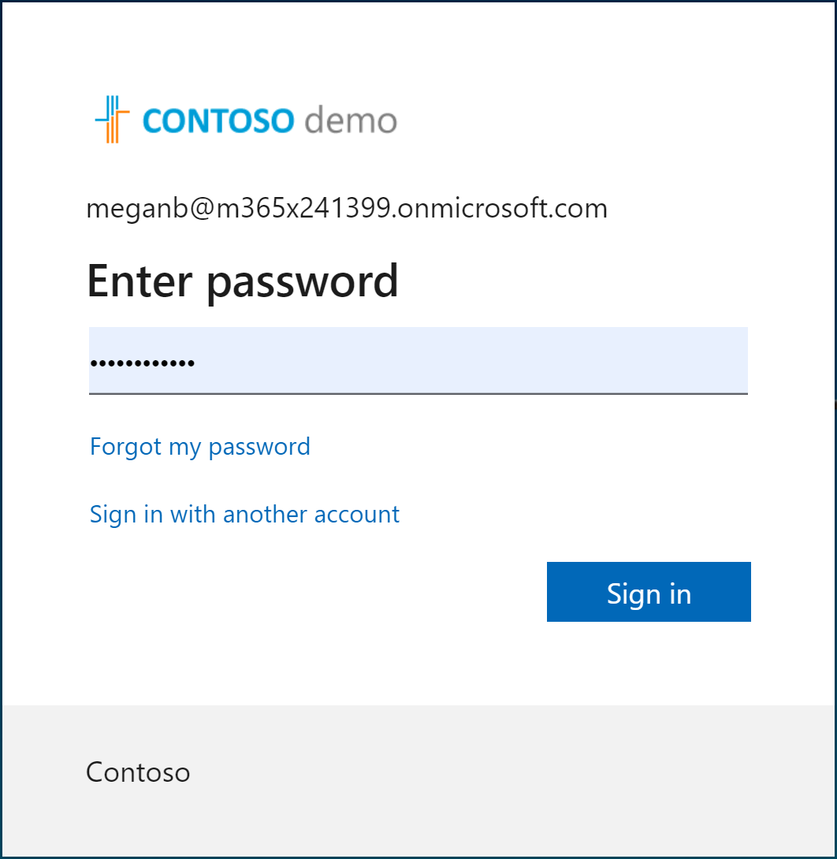
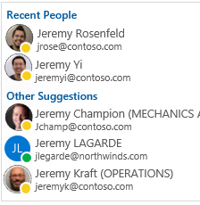
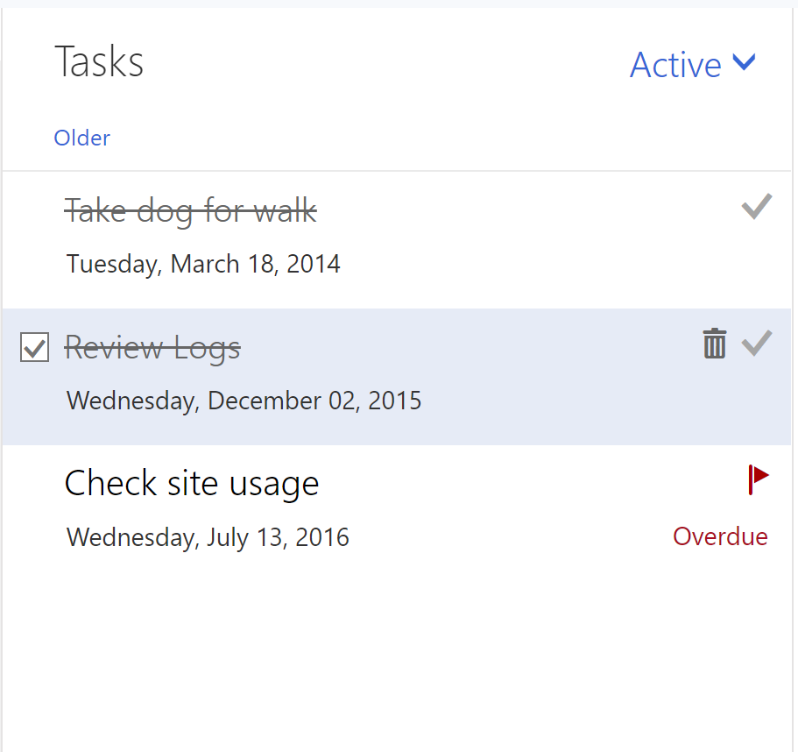
Microsoft Graph Toolkit
A collection of framework-agnostic web components powered by Microsoft Graph
login
people-picker
tasks

Slide 77
Demo: Microsoft Graph Toolkit & Graph Explorer & Simple app

Slide 78

5 tips and tricks to become a Graph coder
Know the 7 basic operations
Learn the 7 basic query parameters
Watch for server-side pagination
Investigate other query patterns (webhook+delta)
Used least privileged permissions

Slide 79
TIP 1 | Know the 7 basic operations
Intent | HTTP METHOD | Description | Example
List | GET | List collection | GET /users
Get | GET | Get member of the collection | GET /users/{id}
Create | POST/PUT | Create new item in the collection | POST /users/ PUT /me/activities/{id}
Update | PATCH/PUT | Update item | PATCH /users/{id} PUT /me/activities/{id}
Delete | DELETE | Delete item | DELETE /users/{id}
Invoke | POST | Invoke operations | POST /domains/{id}/verify
Batch | POST | Execute multiple requests | POST /$batch

Slide 80
POST/PATCH/PUT | no response required
If your code doesn’t need to get a response, then opt out
Don’t send unnecessary data over the wire
Tip
Use HTTP
Prefer return=minimal request header
Some services always return 204 No content for PATCH and PUT

Slide 81
TIP 2 | Learn the 7 basic query parameters
Value | Description | Example
$filter | Filters results (rows) | /users?$filter=startsWith(givenName,’J’)
$select | Filters properties (columns) | /users?$select=givenName,surname
$orderBy | Orders results | /users?$orderBy=displayName desc
$top | Sets the page size of results | /users?$top=10
$expand | Retrieves related resources | /groups?$expand=members
$count | Retrieves the total count of matching resources | /me/messages?$top=2&count=true
$search | Returns results based on search criteria. Currently supported on messages and person collections | /me/messages?$search=pizza

Slide 82
Querying data | Use projections
Choose the properties your app really needs and no more
Don’t send unnecessary data over the wire
Tip
Use $select
GET https://graph.microsoft.com/v1.0/users?
$select=givenName,mail

Slide 83
Querying data | Use filters
Choose the records your app really needs and no more
Don’t send unnecessary data over the wire
Tip
Use $filter
GET https://graph.microsoft.com/v1.0/users?
$filter=department eq ‘Sales’ & $select=givenName,mail

Slide 84
TIP 3 | Watch for server-side pagination
Graph uses server-side page size limits
When querying collections, Graph may return the results in many pages
Always expect an @odata.nextLink property in the response
Contains the URL to the next page

Slide 85
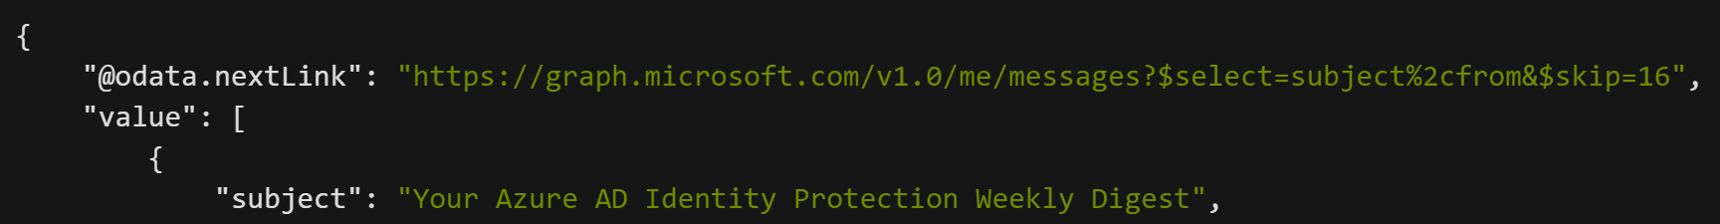
Request
Response
1.
Always handle the possibility that the responses are paged in nature
2.
Follow the @odata.nextLink to obtain the next page of results
3.
Final page will not contain an @odata.nextLink property
4.
Treat the entire URL as an opaque string

Slide 86
TIP 4 | Track changes | Webhooks + Delta query
Scenario
Same scenarios as before, but if you need to optimize further…
Tips
Use webhook notifications as the trigger to make delta query calls
Put notifications in a queue for later processing
Why
Difficult to figure out optimal polling interval

Slide 87
TIP 5 | Used least privileged permissions
Use least privilege! Only request permissions which are absolutely necessary, and only when you need them
Be thoughtful when configuring your app! This will directly affect end user and admin experiences, along with app adoption and security
When building a multi-tenant app, expect customers to have various application and consent controls in different states
Don’t use AppOnly for user interactive scenarios

Slide 88
5 tips and tricks to become a Graph coder
Know the 7 basic operations
Learn the 7 basic query parameters
Watch for server-side pagination
Investigate other query patterns (webhook+delta)
Used least privileged permissions

Slide 89
Migrate from Azure AD Graph
https://docs.microsoft.com/en-us/graph/migrate-azure-ad-graph-planning-checklist
Step 1: Review the differences between the APIs
Step 2: Examine API use
Step 3: Review app details
Step 4: Deploy, test, and extend your app

Slide 90
Questions?

Slide 91
91

